Slide 1
IOT Based Garage Door Opener
Presented by: Manpreet Kaur
C0757604
Group 4

Slide 2
Designing PCB and Creating Gerber Files

Slide 3
Content:
Importance of PCB Designing in this project
Introduction to PCB Designing
Types of PCB
EasyEDA Software : Features, Usage
Troubleshooting
Conclusion
References

Slide 4
Importance of PCB designing in our project
The Printed Circuit board is very important in all electronic gadgets.which are used either for domestic use, or for industrial purpose. PCB design services are used to design the electronic circuits. Apart from electrically connecting, it also gives mechanical support to the electrical components. We are also using various components in our project for which we need PCB board and therefore PCB designing is important. In this presentation, I will discuss how achieved this goal of my project.

Slide 5
PCB designing: Introduction
A printed circuit board is a rigid structure that contains electrical circuitry made up of embedded metal wires called traces, and larger areas of metal called planes. Electronic components are soldered to the top, bottom, or both layers of the board onto metal pads. These pads are connected to the board circuitry allowing the components to be interconnected together. The board may be composed of either a single layer of circuitry, circuitry on the top and bottom, or of multiple layers of circuitry stacked together.

Slide 6
PCB designing : Types
Single side PCBs: Single sided PCBs are the basic type of circuit boards, which contain only one layer of substrate or base material. The layer is covered with a thin layer of metal, i.e. copper- which is a good conductor of electricity.
Double Sided PCBs: Double sided PCBs have both the sides of the substrate featuring metal conductive layer. Holes in the circuit board allow the metal parts to be attached from one side to the other. These PCBs connect the circuits on the either side by either of the two mounting schemes, namely through-hole technology and surface mount technology.

Slide 7
PCB designing : Types
Multilayer PCBs: Multi-layer PCBs are printed circuit boards, which comprise more than two copper layers like 4L, 6L, 8L, etc. These PCBs expand the technology used in double sided PCBs.
Rigid PCBs: Rigid PCBs refer to those types of PCBs whose base material is fabricated from a solid material and which cannot be bent.
Flexible PCBs: Flexible PCBs are constructed on a flexible base material. These PCBs come in single sided, double-sided and multilayer formats. This helps in reducing the complexity within the device assembly.

Slide 8
PCB designing : Types
High Frequency PCBs: High-frequency PCBs are used in the frequency range of 500 MHz – 2 GHz. These PCBs are used in various frequency critical applications like communication systems, microwave PCBs, microstrip PCBs, etc.
Aluminium Backed PCBs: These PCBs are used in high power applications, as the aluminum construction helps in heat dissipation.

Slide 9

EasyEDA: Introduction
EasyEDA is a web-based EDA
tool suite that enables hardware engineers
to design, simulate, share - publicly
and privately - and discuss schematics,
simulations and printed circuit boards.
Registered users can download
Gerber files from the tool free of
charge; but for a fee, EasyEDA offers
a PCB fabrication service.

Slide 10
EasyEDA : Features
Simple, Easier, Friendly , and Powerful General drawing Capabilities.
Schematic Capture.
PCB Layout and Gerber Files.
Working Anywhere, Anytime and Any Device.
Real- Time team cooperation.
Sharing Online.
Integrated PCB Fabrication.
Direct links to LCSC Components for selection.

Slide 11

Gerber Files:
Gerber files are open ASCII vector format files
that contain information on each physical
board layer of your PCB design. Circuit board
objects,like copper traces, vias, pads, solder
mask and silkscreen images, are all represented
by a flash or draw code, and defined by a series
of vector coordinates. These files are used by
PCB manufacturers to translate the details
of your design into the physical properties
of the PCB.

Slide 12
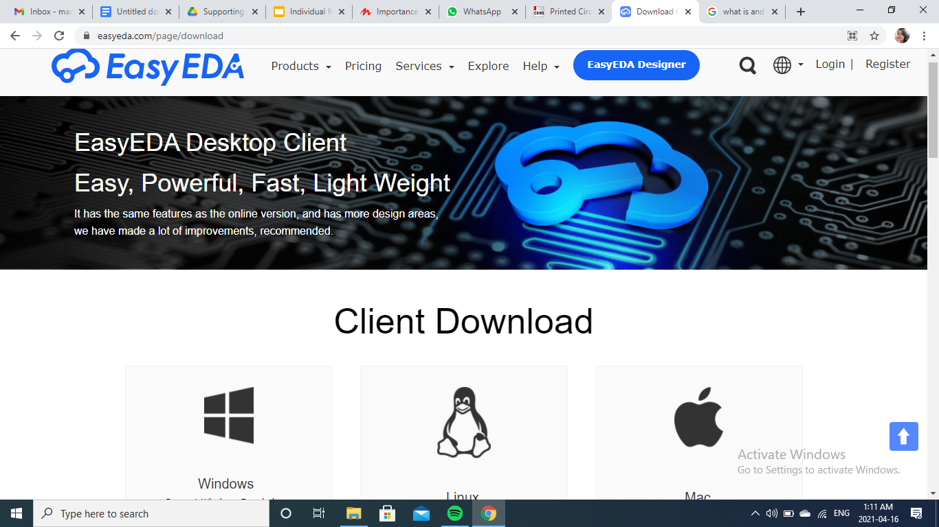
EasyEDA: Download
Go to your browser and type this link https://easyeda.com/page/download

Slide 13
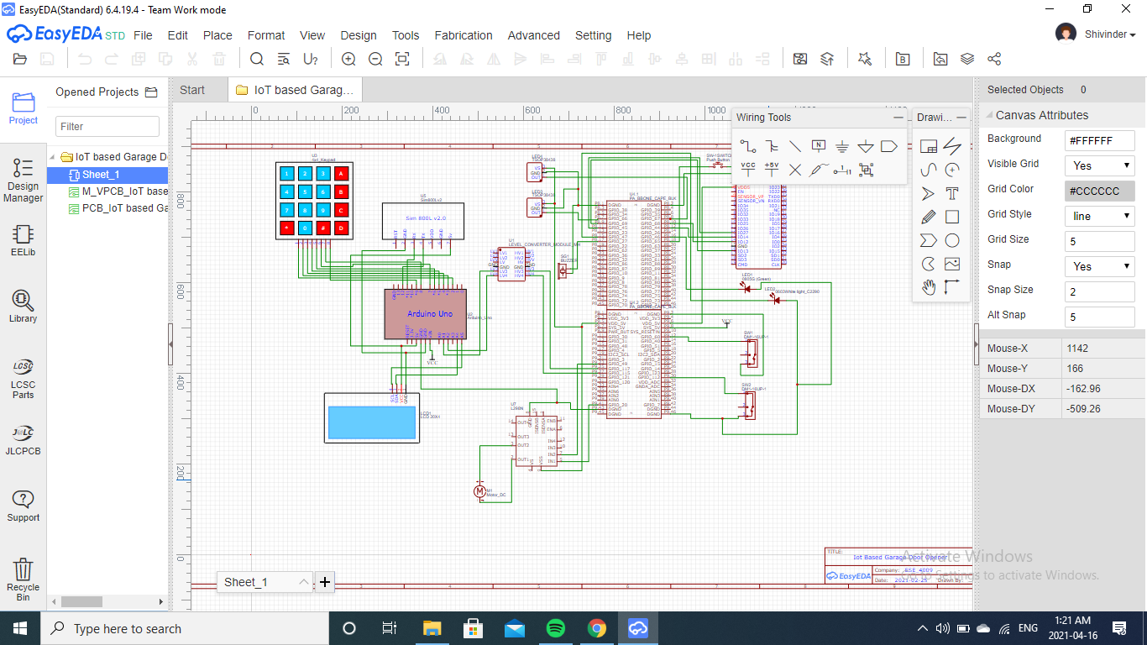
EasyEDA: Usage
Open the sheet with the schematic diagram

Slide 14
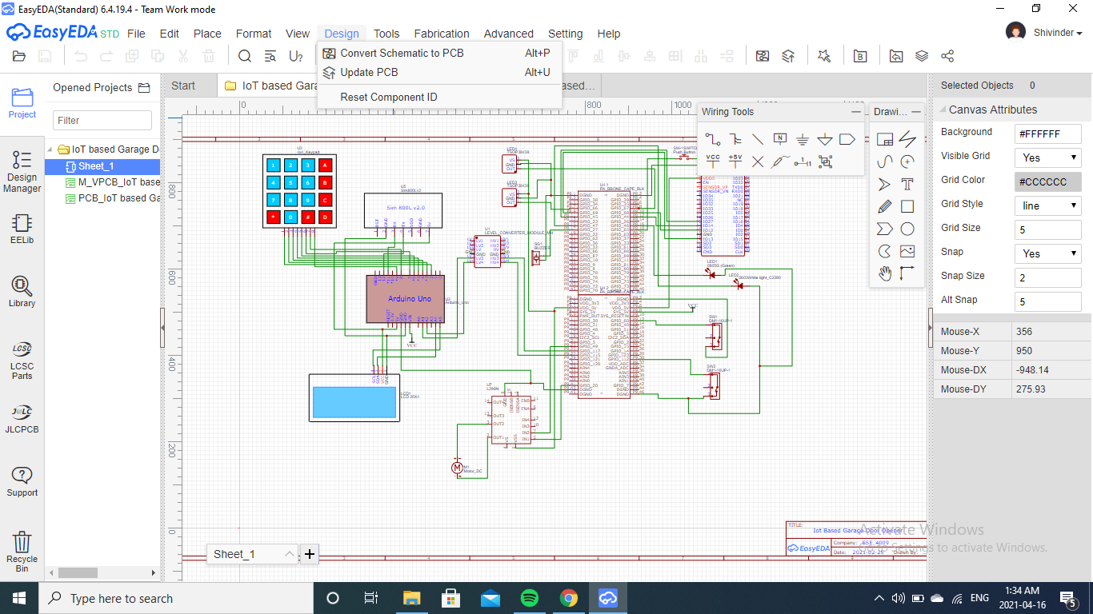
EasyEDA: Usage
Then Go to design and select convert schematic to PCB

Slide 15
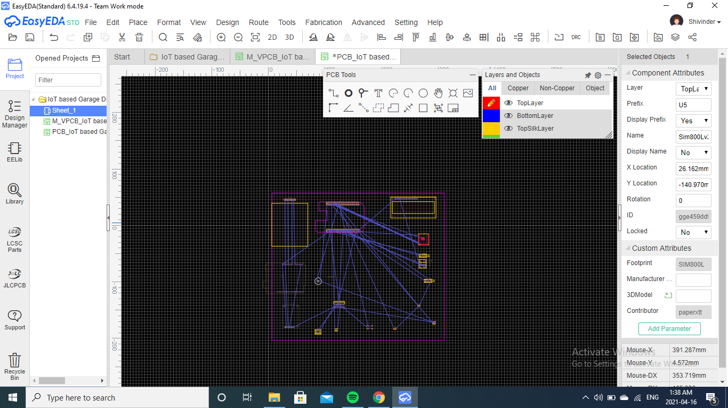
EasyEDA: Usage
Then we put all the components inside the size of PCB Board we selected.

Slide 16
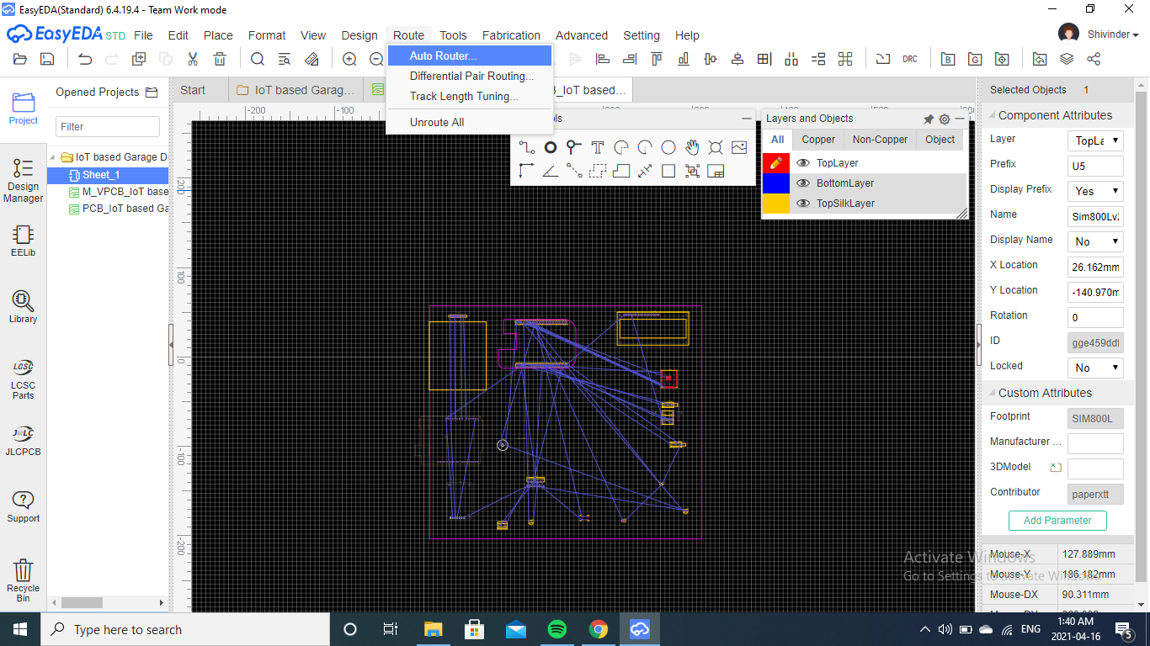
EasyEDA: Usage
Then we put all the components inside the size of PCB Board we selected.
Choose Auto router

Slide 17
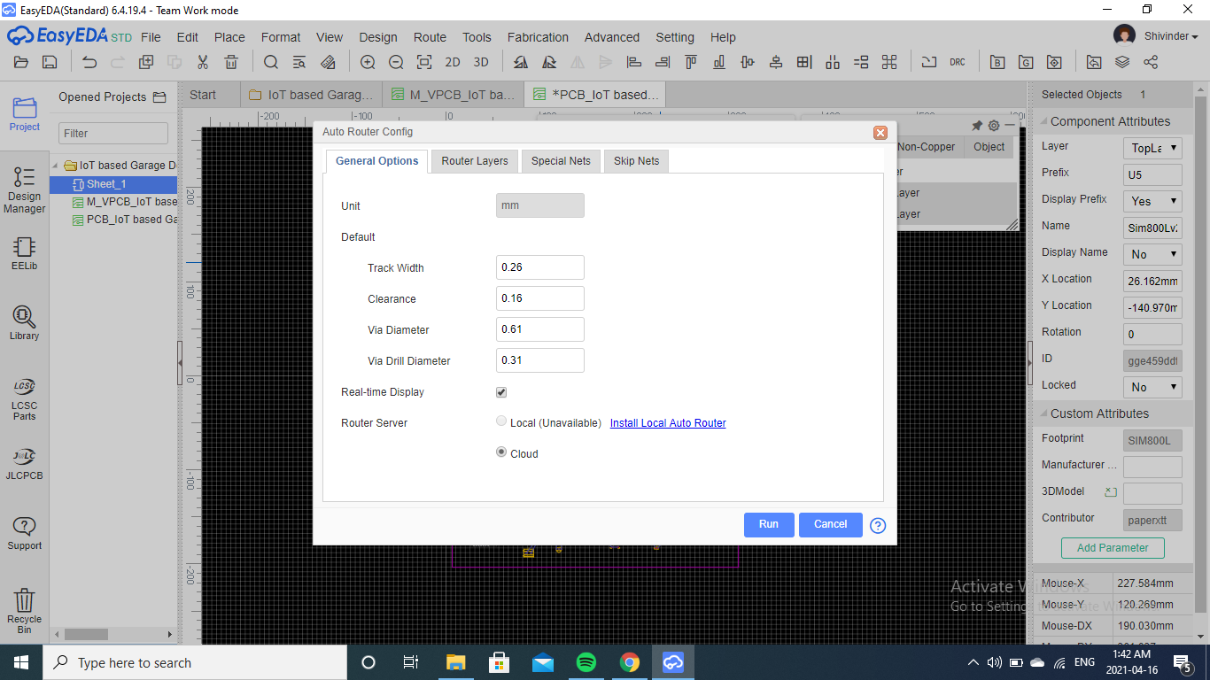
EasyEDA: Usage
Then we put all the components inside the size of PCB Board we selected.
Then choose Local ; we have install local auto router first

Slide 18
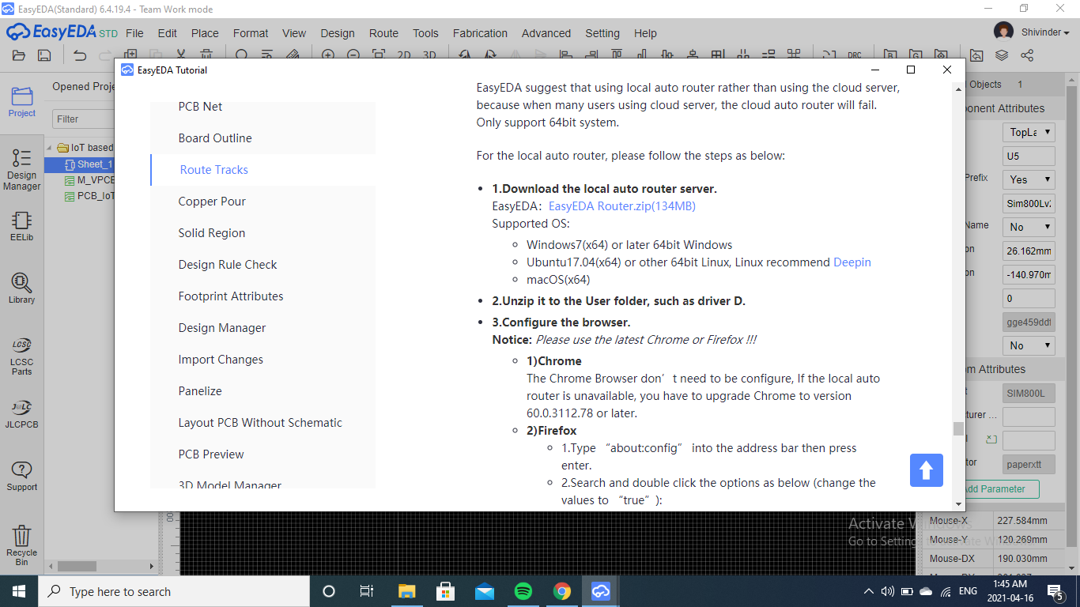
EasyEDA: Usage
Then we put all the components inside the size of PCB Board we selected.
Click on this link and download zip file; follow the steps mentioned following.

Slide 19
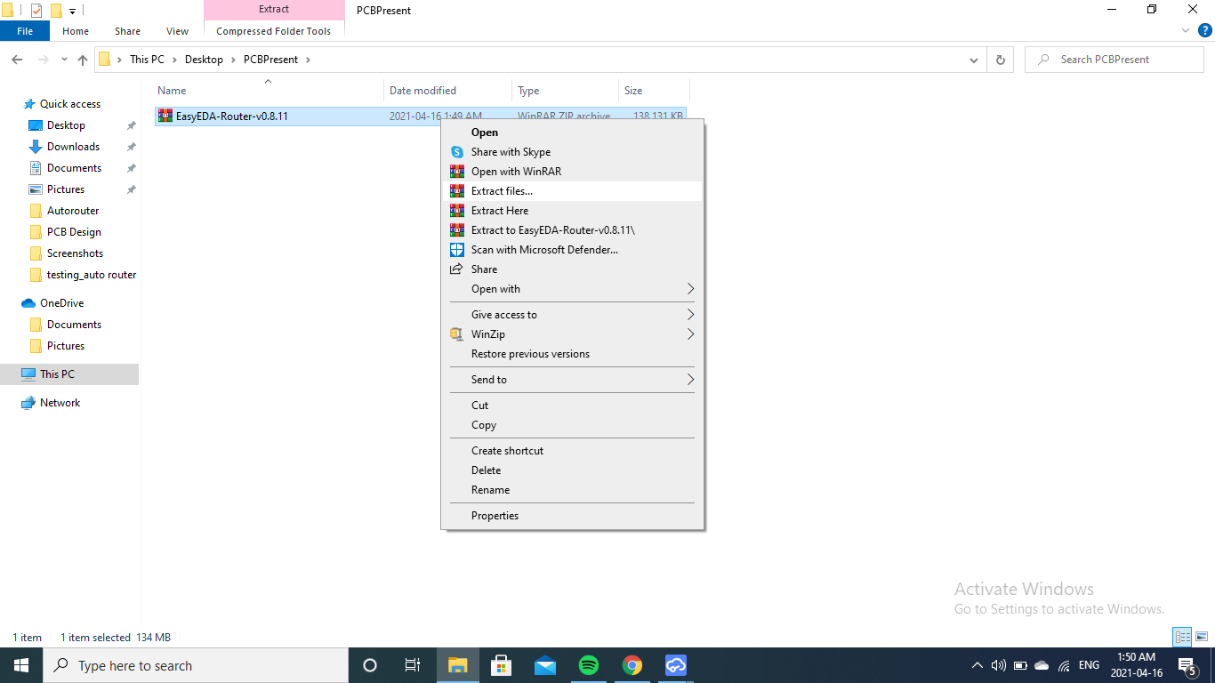
EasyEDA: Usage
Extract the zip file in the folder on your machine.
Then we put all the components inside the size of PCB Board we selected.

Slide 20
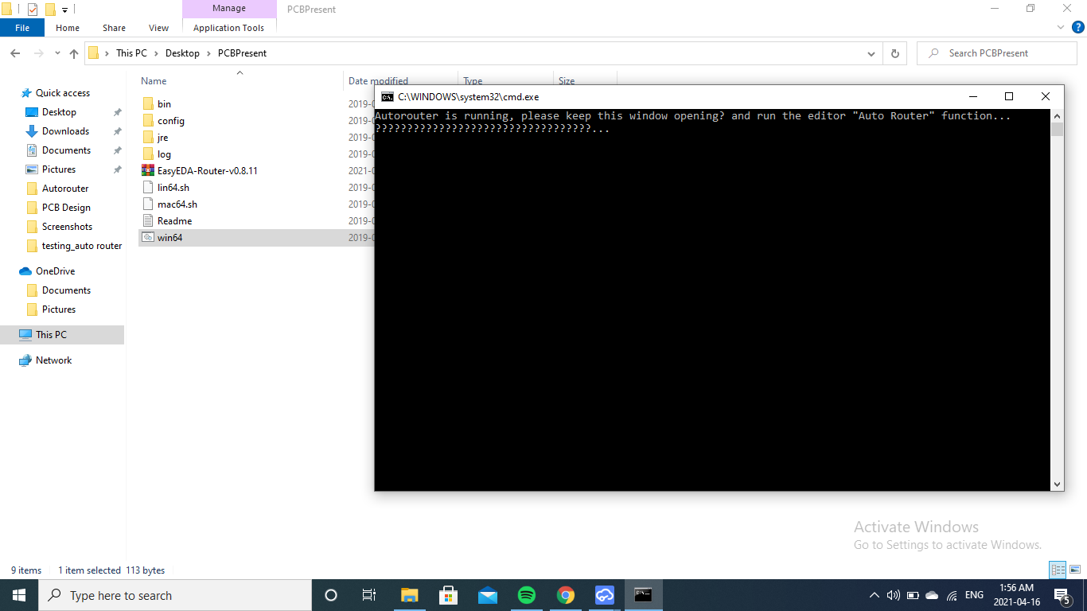
EasyEDA: Usage
Then we put all the components inside the size of PCB Board we selected.
By Selecting Win64; this window will open

Slide 21

EasyEDA: Usage
Then we put all the components inside the size of PCB Board we selected.
Local Router is now available

Slide 22
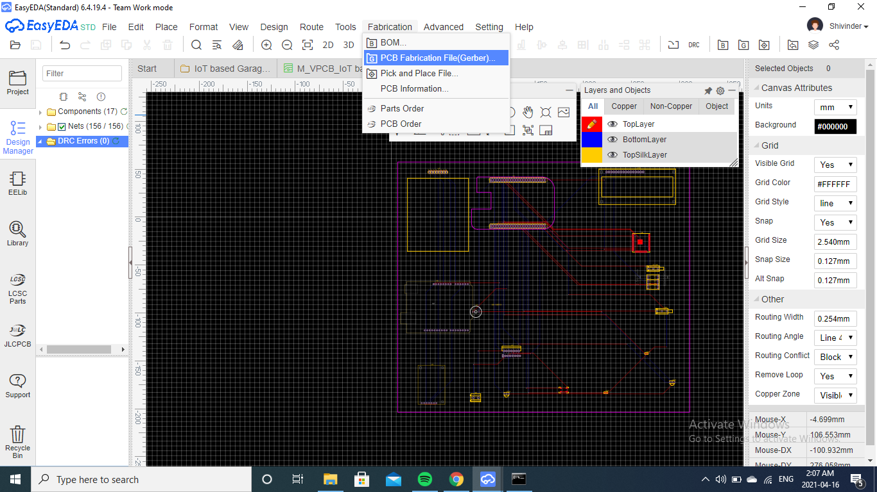
EasyEDA: Usage
Then we put all the components inside the size of PCB Board we selected.
Select PCB Fabrication (Gerber Files)

Slide 23
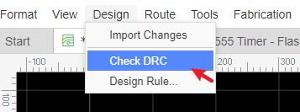
EasyEDA: Usage
EasyEDA provides a real time
DRC(Design Rule Check) function.
This is a big feature of EasyEDA.
Now EasyEDA will let you know
the error in routing. This feature
helps in the better routing of
the circuit.

Slide 24
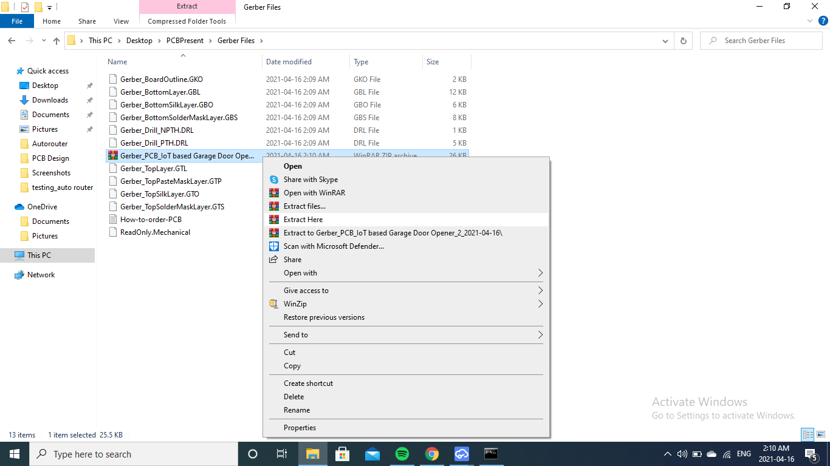
EasyEDA: Usage
Then we put all the components inside the size of PCB Board we selected.
Extract Gerber Files; Multiple Gerber files will appear on the screen

Slide 25
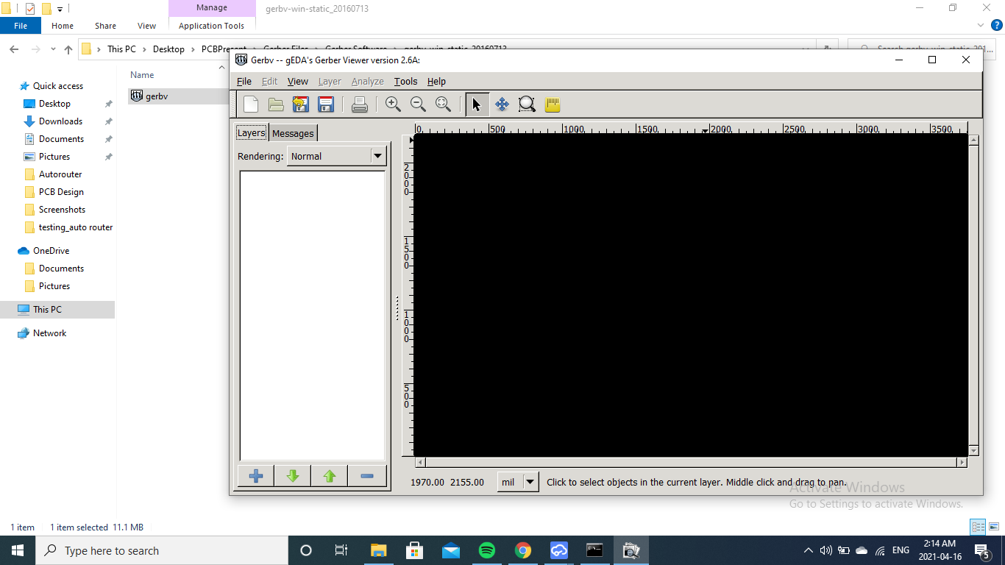
EasyEDA: Usage
Then we put all the components inside the size of PCB Board we selected.
To see Gerber files we need this software; this will allow gerber files to open and check before fabrication on board.

Slide 26
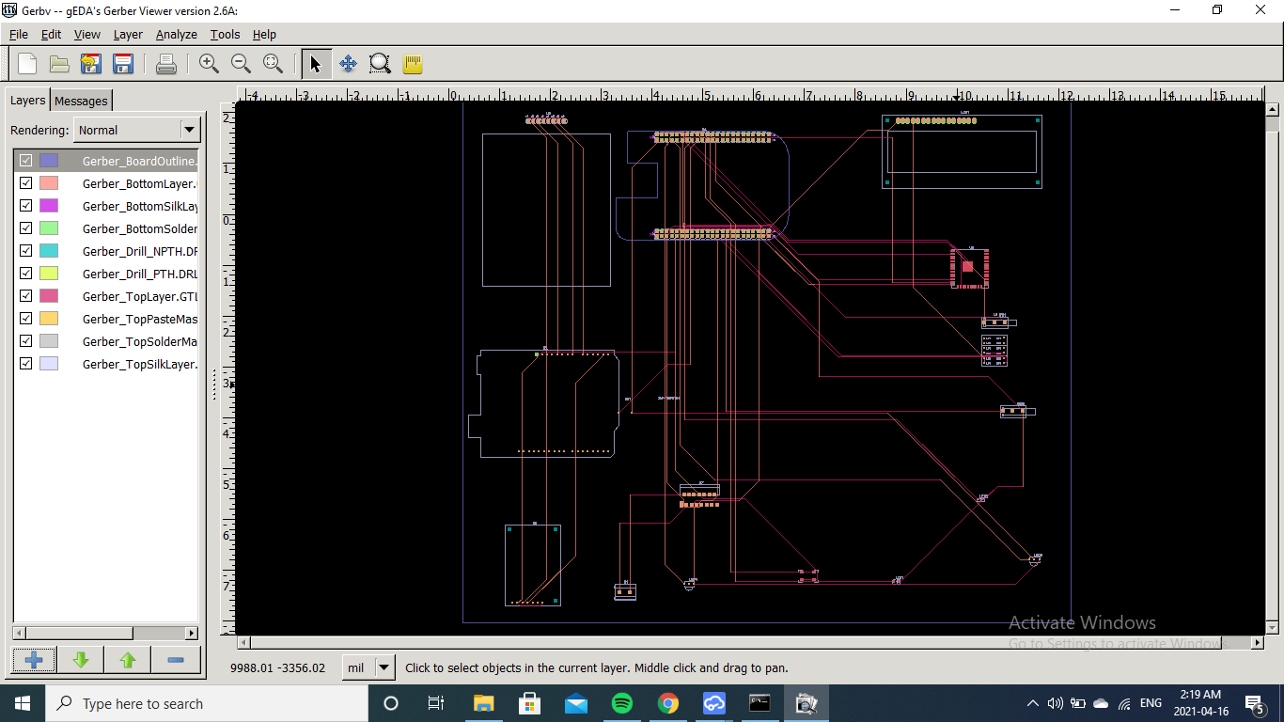
EasyEDA: Usage
Then we put all the components inside the size of PCB Board we selected.
Window will look like this after we open the gerber files

Slide 27
Troubleshooting
While making the PCB fabrication, there was some DRC errors because I did not placed all the components in the selected pcb space. Once I did put all the components in that space there were no errors and my pcb layout was fine.
I had to download the gerber view software as well to see the gerber view. Firstly I installed it incorrectly and it was not working. Then I reinstalled and it was working fine.

Slide 28
Conclusion
The goal to achieve pcb layout and gerber files was achieve by following the steps mentioned in the Earlier slides and this way I was able to do my task for our project.

Slide 29
References:
Retrieved From: twistedtraces.com URL:https://www.twistedtraces.com/blog/learn-about-different-types-of-pcbs-and-their-advantages
Retrieved From: vse.com
URL:https://www.vse.com/blog/2019/10/29/gerber-files-explained-understanding-their-role-in-pcb-manufacturing/
Easy eda full tutorial
Retrieved from: Youtube
URL:https://www.youtube.com/watch?v=q9fgMhfEzko

